Slide 1
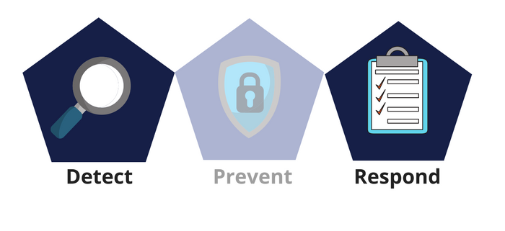



Network Security
Class IX
lab 30

Slide 2


OS Fingerprinting
OS fingerprinting is the process of determining the operating system used by a host on a network

Slide 3

Install Nmap
$sudo apt install nmap

Slide 4
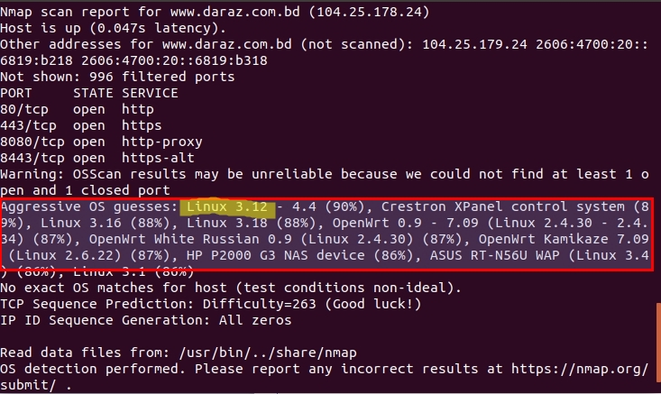
OS Scanning
sudo nmap -O -v www.your-website.com

Slide 5

Quick Fixing of OS Scann
hide your main system
behind a secure proxy
server or a VPN

Slide 6
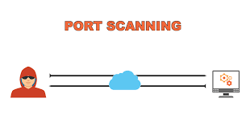
Port Scanning Method
sudo nmap -sT -p 443 www.Your_Website.com

Slide 7
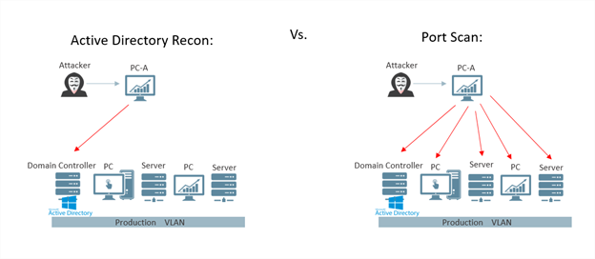
Quick Fixing of Scanned Port
check and close all the unwanted ports to safeguard the system from malicious attacks

Slide 8
DNS Enumeration
Domain Name Server (DNS) is like a distributed database which is used to translate an IP address 192.111.1.120 to a name www.example.com
DNS enumeration is the process of locating all the DNS servers and their corresponding records for an organization

Slide 9
Thank You

